Slide 1
Introduction to Chapter 4
Basic logic gate functions will be combined in combinational logic circuits.
Simplification of logic circuits will be done using Boolean algebra and a mapping technique.
Troubleshooting of combinational circuits will be introduced.
PLD and HDL control structures will be explained.
Ronald Tocci/Neal Widmer/Gregory Moss
Digital Systems: Principles and Applications, 10e
Copyright ©2007 by Pearson Education, Inc.
Columbus, OH 43235
All rights reserved..

Slide 2
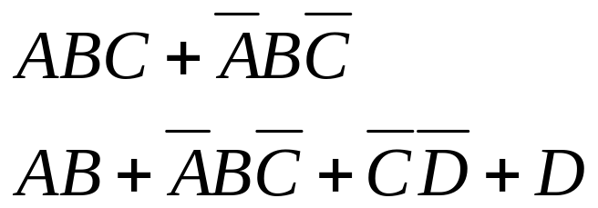
4-1 Sum-of-Products Form
A Sum-of-products (SOP) expression will appear as two or more AND terms ORed together.
Ronald Tocci/Neal Widmer/Gregory Moss
Digital Systems: Principles and Applications, 10e
Copyright ©2007 by Pearson Education, Inc.
Columbus, OH 43235
All rights reserved..

Slide 3
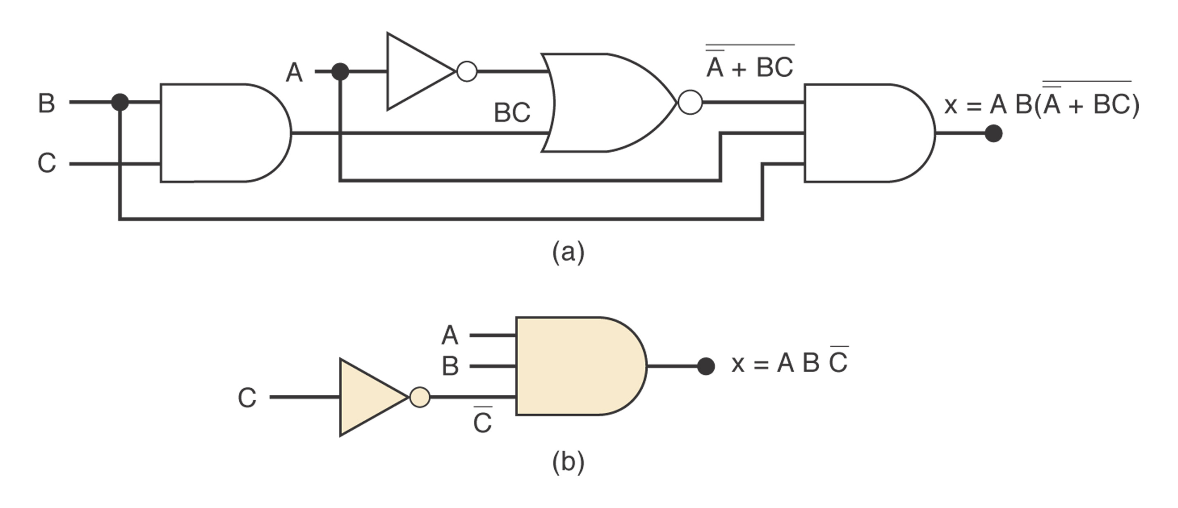
4-2 Simplifying Logic Circuits
The circuits below both provide the same output, but the lower one is clearly less complex.
We will study simplifying logic circuits using Boolean algebra and Karnaugh mapping
Ronald Tocci/Neal Widmer/Gregory Moss
Digital Systems: Principles and Applications, 10e
Copyright ©2007 by Pearson Education, Inc.
Columbus, OH 43235
All rights reserved..

Slide 4
4-3 Algebraic Simplification
Place the expression in SOP form by applying DeMorgan’s theorems and multiplying terms.
Check the SOP form for common factors and perform factoring where possible.
Note that this process may involve some trial and error to obtain the simplest result.
Ronald Tocci/Neal Widmer/Gregory Moss
Digital Systems: Principles and Applications, 10e
Copyright ©2007 by Pearson Education, Inc.
Columbus, OH 43235
All rights reserved..

Slide 5
4-4 Designing Combinational Logic Circuits
To solve any logic design problem:
  Interpret the problem and set up its truth table.
  Write the AND (product) term for each case where the output equals 1.
  Combine the terms in SOP form.
  Simplify the output expression if possible.
  Implement the circuit for the final, simplified expression.
Ronald Tocci/Neal Widmer/Gregory Moss
Digital Systems: Principles and Applications, 9e
Copyright ©2004 by Pearson Education, Inc.
Upper Saddle River, New Jersey 07458
All rights reserved.

Slide 6
4-5 Karnaugh Map Method
A graphical method of simplifying logic equations or truth tables. Also called a K map.
Theoretically can be used for any number of input variables, but practically limited to 5 or 6 variables.
Ronald Tocci/Neal Widmer/Gregory Moss
Digital Systems: Principles and Applications, 10e
Copyright ©2007 by Pearson Education, Inc.
Columbus, OH 43235
All rights reserved..

Slide 7

4-5 Karnaugh Map Method
The truth table values are placed in the K map as shown in figure 4-11.
Adjacent K map square differ in only one variable both horizontally and vertically.
The pattern from top to bottom and left to right must be in the form
A SOP expression can be obtained by ORing all squares that contain a 1.
Ronald Tocci/Neal Widmer/Gregory Moss
Digital Systems: Principles and Applications, 10e
Copyright ©2007 by Pearson Education, Inc.
Columbus, OH 43235
All rights reserved..

Slide 8
4-5 Karnaugh Map Method
Looping adjacent groups of 2, 4, or 8 1s will result in further simplification.
When the largest possible groups have been looped, only the common terms are placed in the final expression.
Looping may also be wrapped between top, bottom, and sides.
Figures 4-13 and 4-14 illustrate looping
Ronald Tocci/Neal Widmer/Gregory Moss
Digital Systems: Principles and Applications, 10e
Copyright ©2007 by Pearson Education, Inc.
Columbus, OH 43235
All rights reserved..

Slide 9
4-5 Karnaugh Map Method
Complete K map simplification process:
  Construct the K map, place 1s as indicated in the truth table.
  Loop 1s that are not adjacent to any other 1s. Isolated 1s.
  Loop 1s that are adjacent to only one other 1. Loop any pair containing such a 1.
  Loop 1s in octets even if they have already been looped.
  Loop quads that have one or more 1s not already looped.
  Loop any pairs necessary to include 1st not already looped.
  Form the OR sum of terms generated by each loop.
Ronald Tocci/Neal Widmer/Gregory Moss
Digital Systems: Principles and Applications, 10e
Copyright ©2007 by Pearson Education, Inc.
Columbus, OH 43235
All rights reserved..

Slide 10
4-6 Exclusive OR and Exclusive NOR Circuits
The exclusive OR (XOR) produces a HIGH output whenever the two inputs are at opposite levels.
The exclusive NOR (XNOR) produces a HIGH output whenever the two inputs are at the same level.
XOR and XNOR outputs are opposite.
Ronald Tocci/Neal Widmer/Gregory Moss
Digital Systems: Principles and Applications, 10e
Copyright ©2007 by Pearson Education, Inc.
Columbus, OH 43235
All rights reserved...

Slide 11
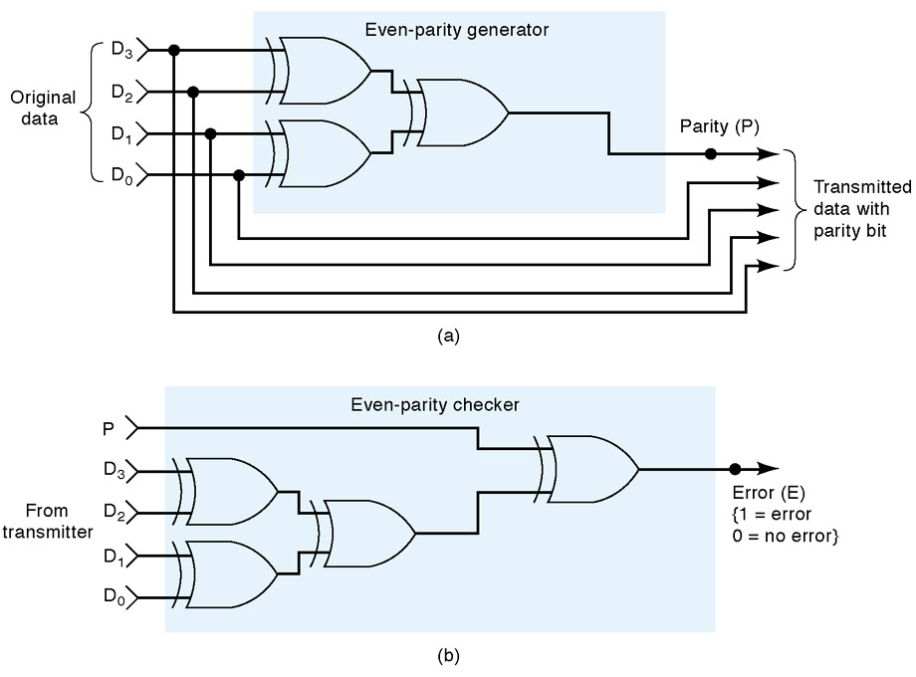
4-7 Parity Generator and Checker
XOR and XNOR
gates are useful in
circuits for parity
generation and
checking.
Ronald Tocci/Neal Widmer/Gregory Moss
Digital Systems: Principles and Applications, 10e
Copyright ©2007 by Pearson Education, Inc.
Columbus, OH 43235
All rights reserved..

Slide 12
4-8 Enable/Disable Circuits
A circuit is enabled when it allows the passage of an input signal to the output.
A circuit is disabled when it prevents the passage of an input signal to the output.
Situations requiring enable/disable circuits occur frequently in digital circuit design.
Ronald Tocci/Neal Widmer/Gregory Moss
Digital Systems: Principles and Applications, 10e
Copyright ©2007 by Pearson Education, Inc.
Columbus, OH 43235
All rights reserved..

Slide 13
4-9 Basic Characteristics of Digital ICs
IC “chips” consist of resistors, diodes, and transistors fabricated on a piece of semiconductor material called a substrate.
Digital ICs may be categorized according to the number of logic gates on the substrate:
  SSI – less than 12
  MSI – 12 to 99
  LSI – 100 to 9999
  VLSI – 10,000 to 99,999
  ULSI – 100,000 to 999,999
  GSI – 1,000,000 or more
Ronald Tocci/Neal Widmer/Gregory Moss
Digital Systems: Principles and Applications, 10e
Copyright ©2007 by Pearson Education, Inc.
Columbus, OH 43235
All rights reserved..

Slide 14
4-9 Basic Characteristics of Digital ICs
The first package we will examine is the dual in line package (DIP). The pin numbering scheme is described in figure 4-29.
PLDs have a different numbering scheme that is also described in figure 4-29
Ronald Tocci/Neal Widmer/Gregory Moss
Digital Systems: Principles and Applications, 10e
Copyright ©2007 by Pearson Education, Inc.
Columbus, OH 43235
All rights reserved..

Slide 15
4-9 Basic Characteristics of Digital ICs
ICs are also categorized by the type of components used in their circuits.
  Bipolar ICs use NPN and PNP transistors
  Unipolar ICs use FET transistors.
The transistor-transistor logic (TTL) and the complementary metal-oxide semiconductor (CMOS) families will both be examined.
Ronald Tocci/Neal Widmer/Gregory Moss
Digital Systems: Principles and Applications, 10e
Copyright ©2007 by Pearson Education, Inc.
Columbus, OH 43235
All rights reserved..

Slide 16
4-9 Basic Characteristics of Digital ICs
The TTL family consists of subfamilies as listed in table 4-6.
  The 74 series devices are all part of the standard TTL series.
  The 74LS series devices are all part of the low power Schottky TTL series.
  The differences between devices is limited to electrical characteristics like power dissipation and switching speed. The pin layout and logic operations are the same.
  The 7404, 74S04, 74LS04, and 74ALS04 are all hex (six to a chip) inverters.
Ronald Tocci/Neal Widmer/Gregory Moss
Digital Systems: Principles and Applications, 10e
Copyright ©2007 by Pearson Education, Inc.
Columbus, OH 43235
All rights reserved..

Slide 17
4-9 Basic Characteristics of Digital ICs
The CMOS family consists of several series, some of which are shown in table 4-7.
CMOS devices perform the same function as, but are not necessarily pin for pin compatible with TTL devices.
Characteristics of TTL and CMOS devices will be explored in more detail in chapter 8.
Ronald Tocci/Neal Widmer/Gregory Moss
Digital Systems: Principles and Applications, 10e
Copyright ©2007 by Pearson Education, Inc.
Columbus, OH 43235
All rights reserved..

Slide 18
4-9 Basic Characteristics of Digital ICs
Power (referred to as V_{CC}) and ground connections are required for chip operation.
V_{CC} for TTL devices is normally +5 V.
V_{DD} for CMOS devices can be from +3 to +18 V.
Logic levels for TTL and CMOS devices are shown in figure 4-31.
Ronald Tocci/Neal Widmer/Gregory Moss
Digital Systems: Principles and Applications, 10e
Copyright ©2007 by Pearson Education, Inc.
Columbus, OH 43235
All rights reserved..

Slide 19
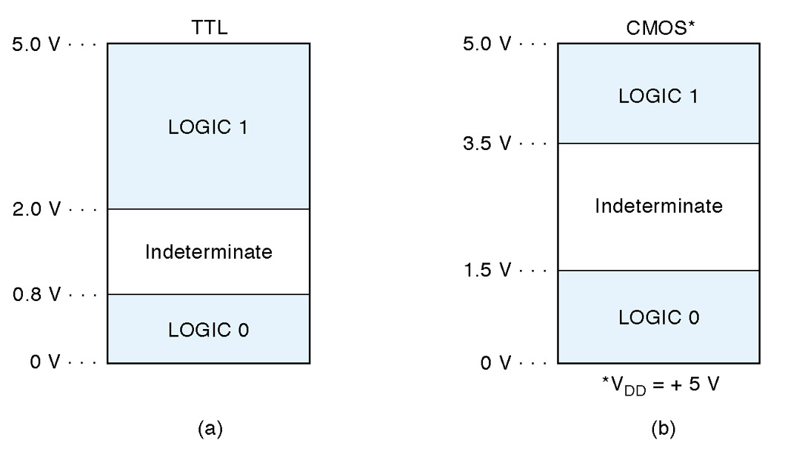
4-9 Basic Characteristics of Digital ICs
Voltages that fall in the indeterminate range will provide unpredictable results and should be avoided.
Ronald Tocci/Neal Widmer/Gregory Moss
Digital Systems: Principles and Applications, 10e
Copyright ©2007 by Pearson Education, Inc.
Columbus, OH 43235
All rights reserved..

Slide 20
4-9 Basic Characteristics of Digital ICs
Inputs that are not connected are said to be floating. The consequences of floating inputs differ for TTL and CMOS.
  Floating TTL input acts like a logic 1. The voltage measurement may appear in the indeterminate range, but the device will behave as if there is a 1 on the floating input.
  Floating CMOS inputs can cause overheating and damage to the device. Some ICs have protection circuits built in, but the best practice is to tie all unused inputs either high or low.
Ronald Tocci/Neal Widmer/Gregory Moss
Digital Systems: Principles and Applications, 10e
Copyright ©2007 by Pearson Education, Inc.
Columbus, OH 43235
All rights reserved..

Slide 21
4-10 Troubleshooting Digital Systems
3 basic steps
  Fault detection, determine operation to expected operation.
  Fault isolation, test and measure to isolate the fault.
  Fault correction, repair the fault.
Good troubleshooting skills come through experience in actual hands-on troubleshooting.
The basic troubleshooting tools used here will be: the logic probe, oscilloscope, and logic pulser.
The most important tool is the technician’s brain.
Ronald Tocci/Neal Widmer/Gregory Moss
Digital Systems: Principles and Applications, 10e
Copyright ©2007 by Pearson Education, Inc.
Columbus, OH 43235
All rights reserved..

Slide 22
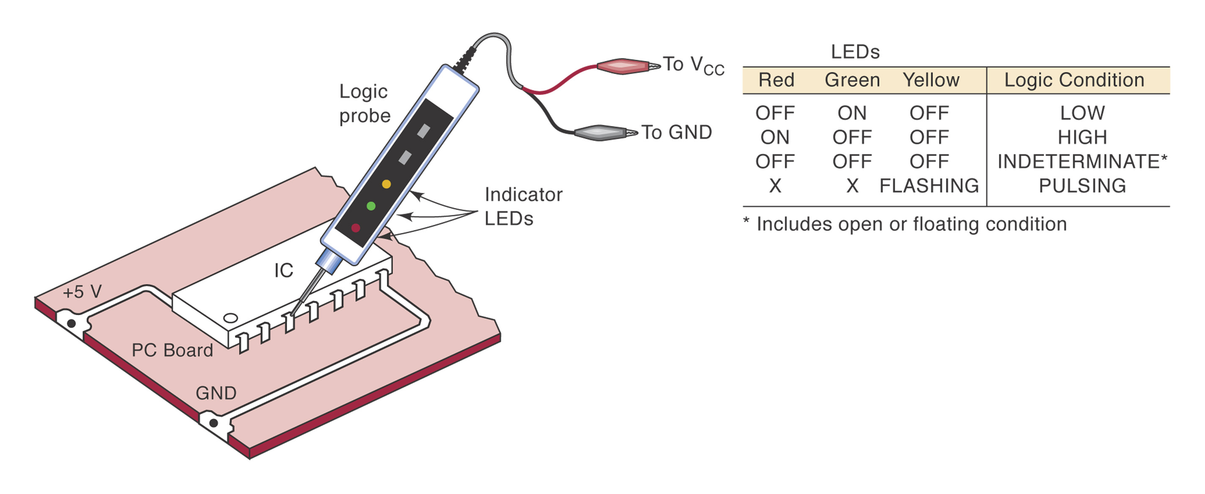
4-10 Troubleshooting Digital Systems
The logic probe will indicate the presence or absence of a signal when touched to a pin as indicated below.
Ronald Tocci/Neal Widmer/Gregory Moss
Digital Systems: Principles and Applications, 10e
Copyright ©2007 by Pearson Education, Inc.
Columbus, OH 43235
All rights reserved..

Slide 23
4-11 Internal Digital IC Faults
Most common internal failures:
  Malfunction in the internal circuitry.
  Inputs or outputs shorted to ground or V_{CC}
  Inputs or outputs open-circuited
  Short between two pins (other than ground or V_{CC})
Ronald Tocci/Neal Widmer/Gregory Moss
Digital Systems: Principles and Applications, 10e
Copyright ©2007 by Pearson Education, Inc.
Columbus, OH 43235
All rights reserved..

Slide 24
4-11 Internal Digital IC Faults
Malfunction in internal circuitry
  Outputs do not respond properly to inputs. Outputs are unpredictable.
Input internally shorted to ground or supply
  The input will be stuck in LOW or HIGH state.
Output internally shorted to ground or supply
  Output will be stuck in LOW or HIGH state.
Open-circuited input or output
  Floating input in a TTL device will result in a HIGH output. Floating input in a CMOS device will result in erratic or possibly destructive output.
  An open output will result in a floating indication.
Short between two pins
  The signal at those pins will always be identical.
Ronald Tocci/Neal Widmer/Gregory Moss
Digital Systems: Principles and Applications, 10e
Copyright ©2007 by Pearson Education, Inc.
Columbus, OH 43235
All rights reserved..

Slide 25
4-12 External Faults
Open signal lines – signal is prevented from moving between points. Some causes:
  Broken wire
  Poor connections (solder or wire-wrap)
  Cut or crack on PC board trace
  Bent or broken IC pins.
  Faulty IC socket
Detect visually and verify with an ohmmeter.
Ronald Tocci/Neal Widmer/Gregory Moss
Digital Systems: Principles and Applications, 10e
Copyright ©2007 by Pearson Education, Inc.
Columbus, OH 43235
All rights reserved..

Slide 26
4-12 External Faults
Shorted signal lines – the same signal will appear on two or more pins. V_{CC} or ground may also be shorted. Some causes:
  Sloppy wiring
  Solder bridges
  Incomplete etching
Detect visually and verify with an ohmmeter.
Ronald Tocci/Neal Widmer/Gregory Moss
Digital Systems: Principles and Applications, 10e
Copyright ©2007 by Pearson Education, Inc.
Columbus, OH 43235
All rights reserved..

Slide 27
4-12 External Faults
Faulty power supply – ICs will not operate or will operate erratically.
  May lose regulation due to an internal fault or because circuits are drawing too much current.
  Always verify that power supplies are providing the specified range of voltages and are properly grounded.
  Use an oscilloscope to verify that AC signals are not present.
Ronald Tocci/Neal Widmer/Gregory Moss
Digital Systems: Principles and Applications, 10e
Copyright ©2007 by Pearson Education, Inc.
Columbus, OH 43235
All rights reserved..

Slide 28
4-12 External Faults
Output loading – caused by connecting too many inputs to the output of an IC.
  Causes output voltage to fall into the indeterminate range.
  This is called loading the output.
  Usually a result of poor design or bad connection.
Ronald Tocci/Neal Widmer/Gregory Moss
Digital Systems: Principles and Applications, 10e
Copyright ©2007 by Pearson Education, Inc.
Columbus, OH 43235
All rights reserved..

Slide 29
4-13 Troubleshooting Case Study
Example 4-28 illustrates the process involved in troubleshooting a fairly simple circuit.
The reasoning process can be applied to more complex digital circuits.
Take the time to carefully study the example and use the opportunities at the end of the chapter to practice and develop troubleshooting skills.
Ronald Tocci/Neal Widmer/Gregory Moss
Digital Systems: Principles and Applications, 10e
Copyright ©2007 by Pearson Education, Inc.
Columbus, OH 43235
All rights reserved..

Slide 30
4-14 Programmable Logic Devices
PLDs allow the design process to be automated.
Designers identify inputs, outputs, and logical relationships.
PLDs are electronically configured to form the defined logic circuits.
Ronald Tocci/Neal Widmer/Gregory Moss
Digital Systems: Principles and Applications, 10e
Copyright ©2007 by Pearson Education, Inc.
Columbus, OH 43235
All rights reserved..

Slide 31
4-14 Programmable Logic Devices
PLD ICs can be programmed out of system or in system.
  For out of system programming the PLD is placed in a fixture called a programmer which is connected to a PC running software that translates and loads the information.
  In system programming is done by connecting directly to four designated “portal” pins while the IC remains in the system. An interface cable connects the PLD to a PC running the software that loads the device.
Ronald Tocci/Neal Widmer/Gregory Moss
Digital Systems: Principles and Applications, 10e
Copyright ©2007 by Pearson Education, Inc.
Columbus, OH 43235
All rights reserved..

Slide 32
4-14 Programmable Logic Devices
Logic circuits can be described using schematic diagrams, logic equations, truth tables, and HDL.
PLD development software can convert any of these descriptions into 1s and 0s and loaded into the PLD.
Altera MAX+PLUS II is an example of development software that allows the user to describe circuits using graphic design files and timing diagrams.
Ronald Tocci/Neal Widmer/Gregory Moss
Digital Systems: Principles and Applications, 10e
Copyright ©2007 by Pearson Education, Inc.
Columbus, OH 43235
All rights reserved..

Slide 33
4-14 Programmable Logic Devices
Hierarchical design – small logic circuits are defined and combined with other circuits to form a large section of a project. Large sections can be combined and connected for form a system.
Top-down design requires the definition of sub sections that will make up the system, and definition of the individual circuits that will make up each sub section.
Each level of the hierarchy can be designed and tested individually.
Ronald Tocci/Neal Widmer/Gregory Moss
Digital Systems: Principles and Applications, 10e
Copyright ©2007 by Pearson Education, Inc.
Columbus, OH 43235
All rights reserved..

Slide 34
4-14 Programmable Logic Devices
A system is built from the bottom up.
  Each block is described by a design file.
  The designed block is tested
  After testing it is compiled using development software.
  The compiled block is tested using a simulator for verify correct operation.
  A PLD is programmed to verify correct operation.
The flowchart in figure 4-48 summarizes the design process for each block of the system.
Ronald Tocci/Neal Widmer/Gregory Moss
Digital Systems: Principles and Applications, 10e
Copyright ©2007 by Pearson Education, Inc.
Columbus, OH 43235
All rights reserved..

Slide 35
4-15 Representing Data in HDL
Binary, hexadecimal, and decimal values are represented in HDL as shown in table 4-8.
In order to describe a port with more than one data bit we assign a name and the number of bits. This is called a bit array or bit vector.
Ronald Tocci/Neal Widmer/Gregory Moss
Digital Systems: Principles and Applications, 10e
Copyright ©2007 by Pearson Education, Inc.
Columbus, OH 43235
All rights reserved..

Slide 36
4-15 Representing Data in HDL
AHDL syntax – a name for the bit vector is followed by the range of index designations enclosed in square brackets. This would appear in the SUBDESIGN section.
  To declare an 8 bit input port called p1:
  p1 [7..0] :INPUT; -- DEFINE AN 8-BIT INPUT PORT
  To assign the 8 bit port p1 to a node named temp:
  VARIABLE temp[7..0] :NODE;
  BEGIN
  temp[]=p1[]
  END
  The empty braces mean that all bits in the array are being connected. Individual bits could be connected by specifying the bits inside the braces.
Ronald Tocci/Neal Widmer/Gregory Moss
Digital Systems: Principles and Applications, 10e
Copyright ©2007 by Pearson Education, Inc.
Columbus, OH 43235
All rights reserved..

Slide 37
4-15 Representing Data in HDL
VHDL syntax – a name for the bit vector is followed by the mode, the type, and the range enclosed in parenthesis. This would appear in the ENTITY section.
  To declare an 8 bit called p1:
  PORT (p1 :IN BIT_VECTOR (7 DOWNTO 0);
  To assign the 8 bit port p1 to a signal named temp:
  SIGNAL temp :BIT_VECTOR (7 DOWNTO 0);
  BEGIN
  temp <=p1;
  END;
  Since no elements are specified, all the bits will be connected. Individual bits could be connected by placing bit number inside parentheses.
Ronald Tocci/Neal Widmer/Gregory Moss
Digital Systems: Principles and Applications, 10e
Copyright ©2007 by Pearson Education, Inc.
Columbus, OH 43235
All rights reserved..

Slide 38
4-15 Representing Data in HDL
VHDL offers some standardized data types in libraries.
Libraries contain collections of VHDL code that can be used to avoid reinventing the wheel.
Many convenient functions such as standard TTL device descriptions are contained in macrofunctions.
Ronald Tocci/Neal Widmer/Gregory Moss
Digital Systems: Principles and Applications, 10e
Copyright ©2007 by Pearson Education, Inc.
Columbus, OH 43235
All rights reserved..

Slide 39
4-16 Truth Tables Using HDL
Circuits can be designed directly from truth tables in HDL.
Figures 4-50 and 4-51 describe the syntax for AHDL and VHDL truth tables respectively.
Ronald Tocci/Neal Widmer/Gregory Moss
Digital Systems: Principles and Applications, 10e
Copyright ©2007 by Pearson Education, Inc.
Columbus, OH 43235
All rights reserved..

Slide 40
4-17 Decision Control Structures in HDL
IF/THEN/ELSE statements provide a framework for making logical decisions in a system.
  IF/THEN is used when there is a choice between doing something and doing nothing.
  IF/THEN/ELSE is used when there is a choice between two possible actions.
Ronald Tocci/Neal Widmer/Gregory Moss
Digital Systems: Principles and Applications, 10e
Copyright ©2007 by Pearson Education, Inc.
Columbus, OH 43235
All rights reserved..

Slide 41
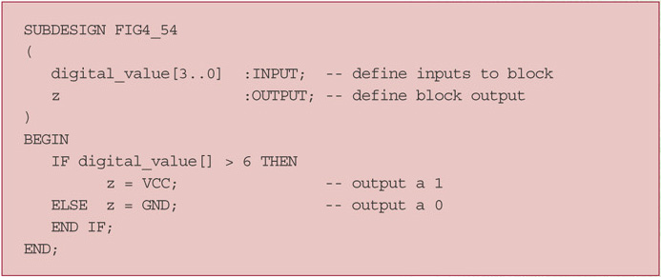
4-17 Decision Control Structures in HDL
The IF/THEN/ELSE in AHDL:
Ronald Tocci/Neal Widmer/Gregory Moss
Digital Systems: Principles and Applications, 10e
Copyright ©2007 by Pearson Education, Inc.
Columbus, OH 43235
All rights reserved..

Slide 42
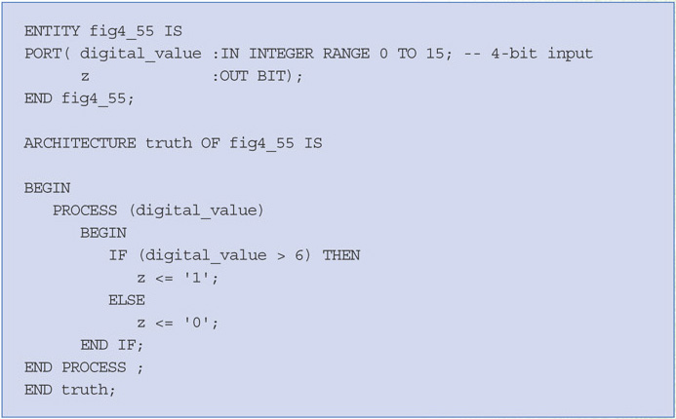
4-17 Decision Control Structures in HDL
The IF/THEN/ELSE in VHDL:
Ronald Tocci/Neal Widmer/Gregory Moss
Digital Systems: Principles and Applications, 10e
Copyright ©2007 by Pearson Education, Inc.
Columbus, OH 43235
All rights reserved..

Slide 43
4-17 Decision Control Structures in HDL
The CASE construct determines the value of an expression or object and then goes through a list of values (cases) to determine what action to take.
This is different than the IF/ELSEIF because there is only one action or match for a case statement.
Ronald Tocci/Neal Widmer/Gregory Moss
Digital Systems: Principles and Applications, 10e
Copyright ©2007 by Pearson Education, Inc.
Columbus, OH 43235
All rights reserved..

Slide 44
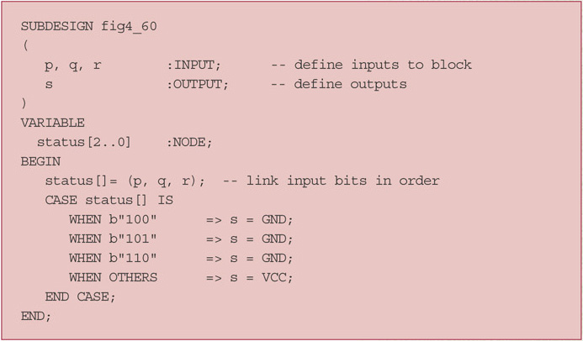
4-17 Decision Control Structures in HDL
The case construct in AHDL:
Ronald Tocci/Neal Widmer/Gregory Moss
Digital Systems: Principles and Applications, 10e
Copyright ©2007 by Pearson Education, Inc.
Columbus, OH 43235
All rights reserved..

Slide 45
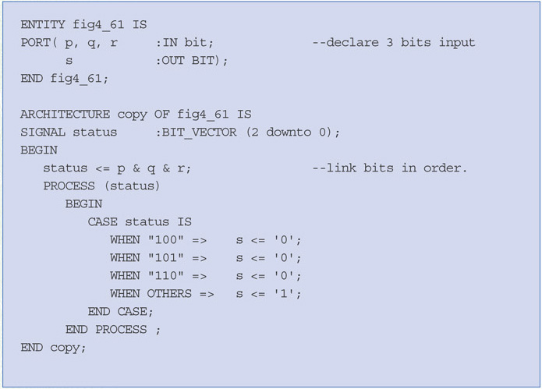
4-17 Decision Control Structures in HDL
The case construct in VHDL:
Ronald Tocci/Neal Widmer/Gregory Moss
Digital Systems: Principles and Applications, 10e
Copyright ©2007 by Pearson Education, Inc.
Columbus, OH 43235
All rights reserved..

